Slide 1

Scene Detection Algorithm Evaluation by Vision-Language Models
School of Electrical Engineering, Tel Aviv University!
Naor Cohen, Or Trabelsi

Slide 2
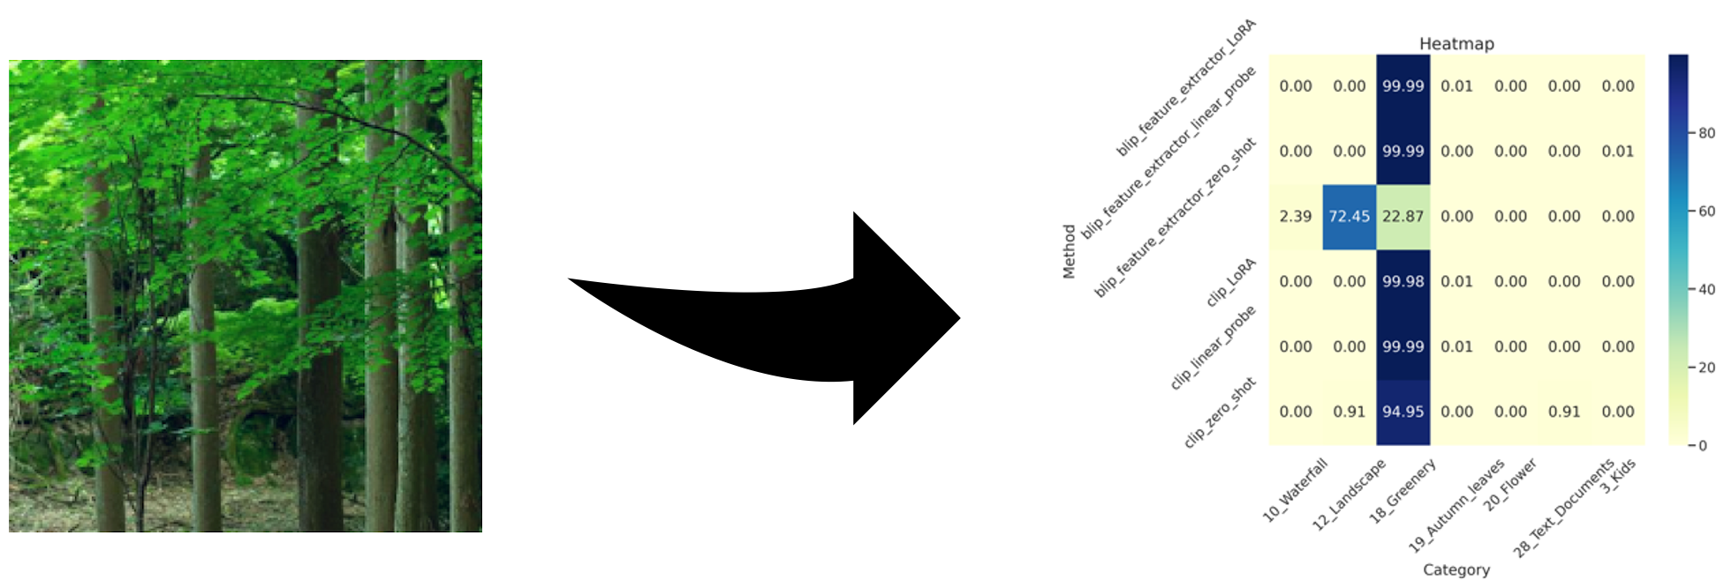
Introduction
Scene Detection: A pivotal software technique in digital photography for categorizing scene types within images - landscapes, portraits, food, low-light settings, etc.
Importance: Lays the foundation for image quality enhancement in camera applications.
Goal: Evaluate pre-trained algorithms - CLIP, BLIP, BLIP-2 on real-world photos for scene detection.

Slide 3
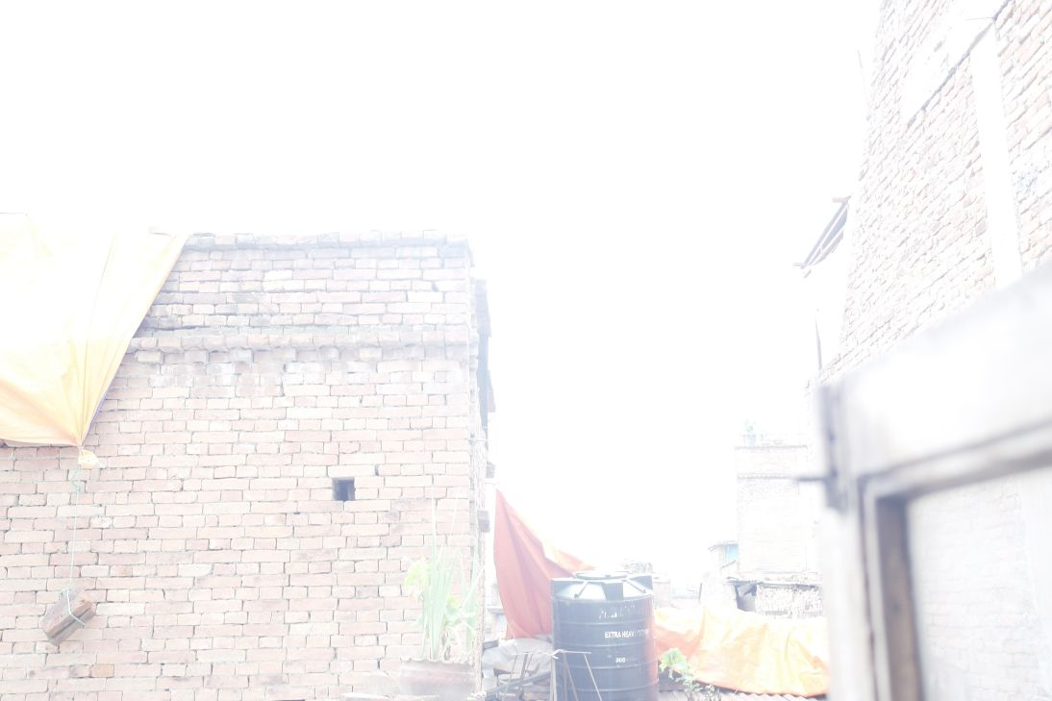
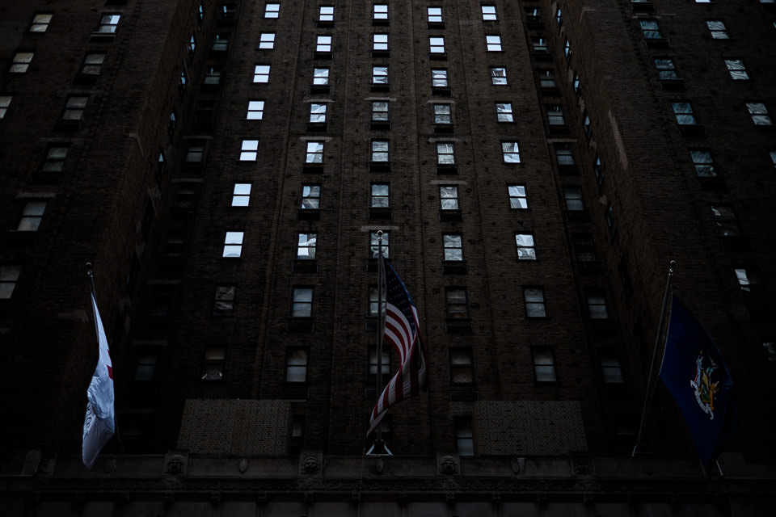
Bright Scene
Dark Scene

Slide 4
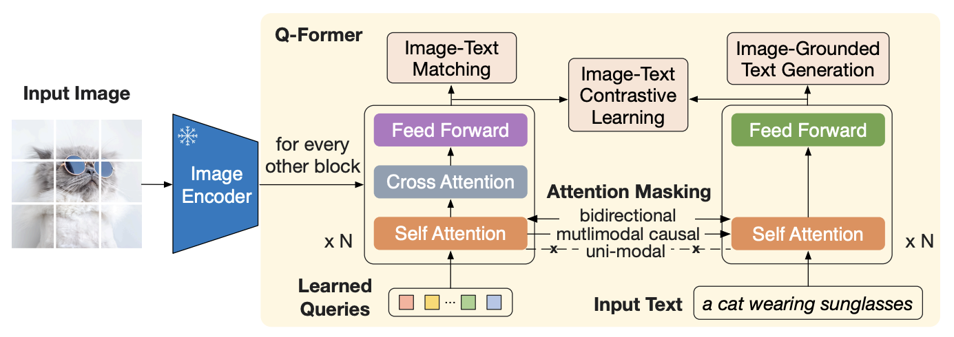
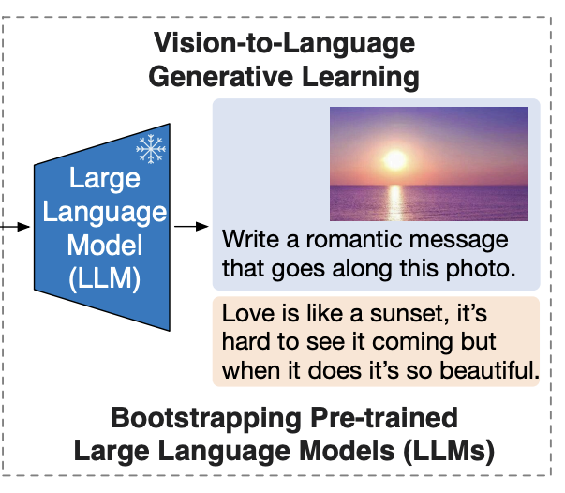
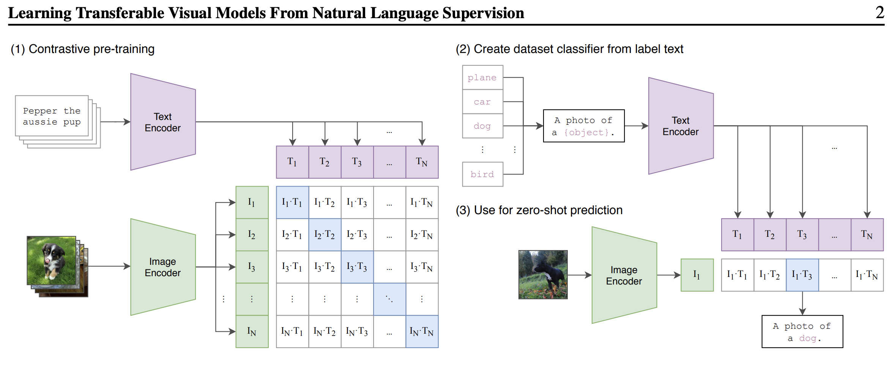
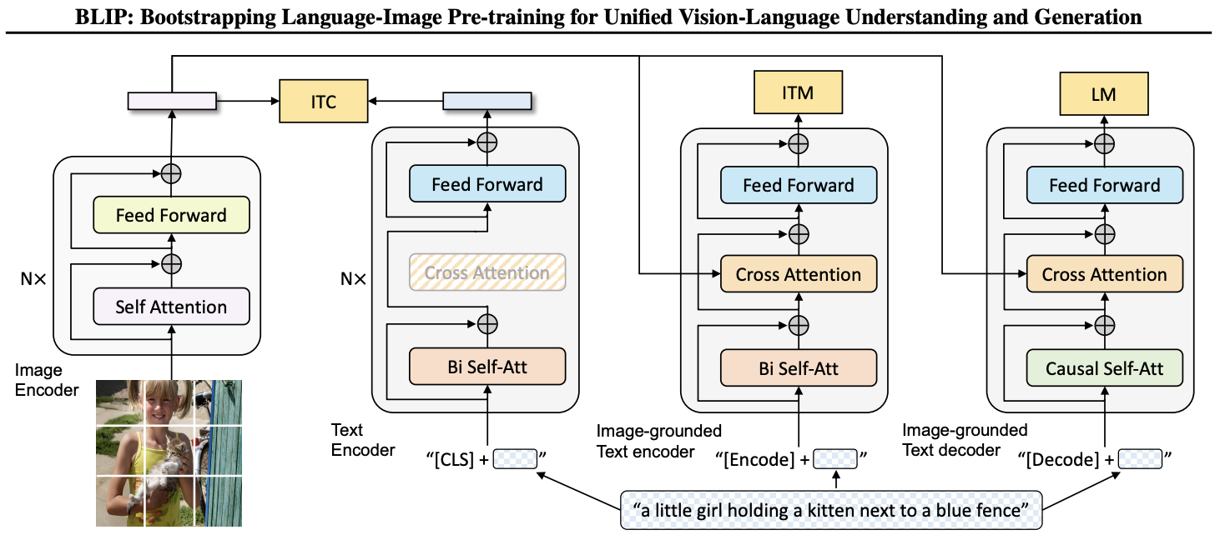
Related Work
Image From Blip-2 Paper [5]
CLIP: Integrates vision and language processing for enhanced scene detection.
BLIP: Improves classifiers using pseudo-labels generated by CLIP.
BLIP-2: Focuses on efficient pre-training methods for enhanced performance.
CamSDD dataset: Facilitates the development of real-world scene detection techniques.
Places365 dataset: A comprehensive collection for training and testing scene
Zero-shot configurations: Expose inherent capabilities in scene detection.
Linear Probe: Fine-tunes models while preserving pre-trained features.
Low-Rank Adaptation (LoRA): Offers a structured approach for fine-tuning models.
Image From Clip Paper [3]
Image From Blip Paper [4]

Slide 5
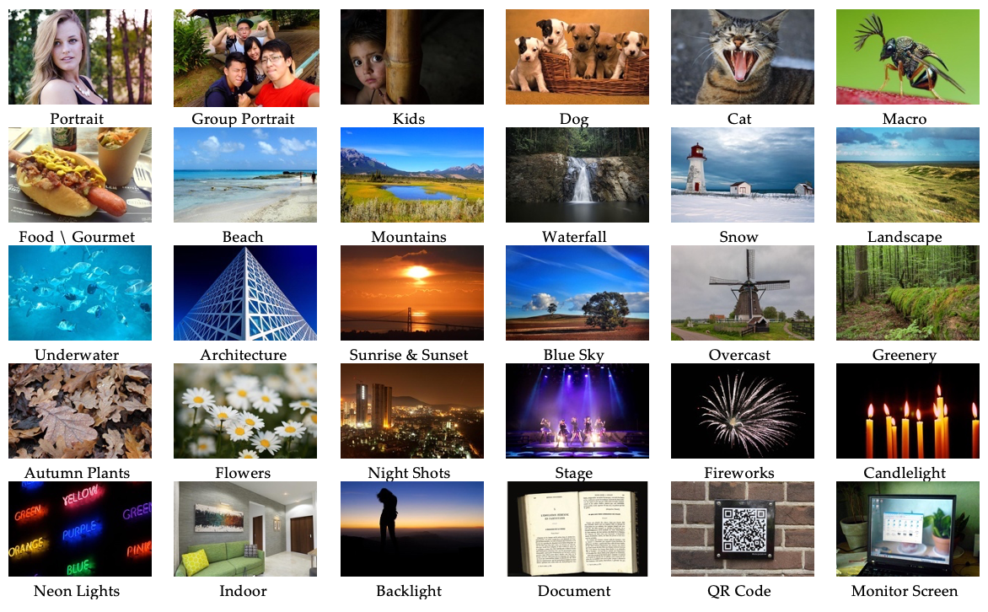
Datasets
Camera Scene Detection Dataset (CamSDD) with 30 diverse categories.
Places365 standard dataset for extensive image collection.
Importance of diverse datasets in evaluating scene detection algorithms.
 | Train | Validation | Test | Categories
CamSDD | ~9.9k | 600 | 600 | 30
Places365 | ~1.8M | 36k | - | 365

Slide 6






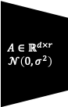

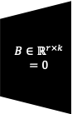

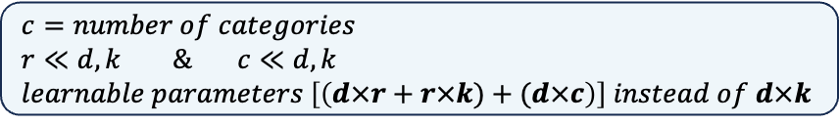
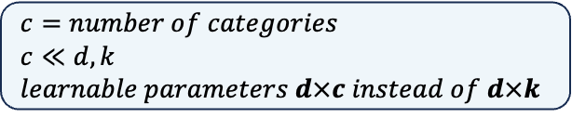

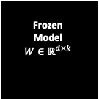

Methodology
Fine-Tuning Techniques Overview
Linear Probe
Fine-tuning with a simple linear classifier applied to
pretrained model weights.
LoRA (Low-Rank Adaptation)
Fine-tuning by introducing low-rank matrices
A and B to adapt pretrained models.
Frozen
Model
$$W∈ℝ^{d×k}$$
$c=number of categories$
$c≪d,k$
$learnable parameters d×c instead of d×k$
$y=softmax\left(W_{c}h+b_{c}\right) ∈ℝ^{c}$
$$x∈ℝ^{d}$$
Categories
Frozen
Model
$$W∈ℝ^{d×k}$$
$$h=\left(W+AB\right)x ∈ℝ^{d}$$
$c=number of categories$
$r≪d,k \& c≪d,k$
$learnable parameters \left[\left(d×r+r×k)+(d×c\right)\right] instead of d×k$
$y=softmax\left(W_{c}h+b_{c}\right) ∈ℝ^{c}$
$$x∈ℝ^{d}$$
$$A∈ℝ^{d×r}$$
$$𝒩\left(0,σ^{2}\right)$$
$$B∈ℝ^{r×k}$$
$$=0$$
Categories
Notes:
x

Slide 7
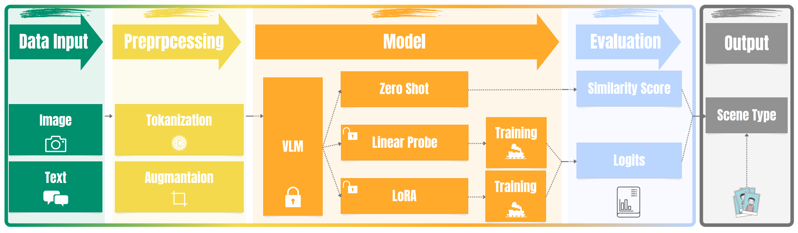
Methodology
Methodology
Data preprocessed per CLIP, and BLIP guidelines.
Images: Convert to RGB, resize, crop, normalize using mean and std.
Texts: appending a prompt and truncating words to a maximum length
Utilized CLIP, BLIP, and BLIP-2 algorithms.
Employed Linear Probe, LoRA for efficient fine-tuning.
Training on CamSDD, Places365 datasets.
Evaluated using TOP-1, and TOP-3 accuracy metrics.

Slide 8
Results Overview
Results Overview
Accuracy Metrics Comparison
Linear Probe fine-tuning exceeds traditional models in Top-1 accuracy.
Perfect 100% Top-3 accuracy with Linear Probe.
Near-perfect Top-3 accuracy with LoRA fine-tuning.
The narrative of fine-tuning unlocking new accuracy horizons.
CamSDD
Places365
Method | Top-1 Acc. % | Top-3 Acc. %
zero-shot
CLIP | 87.83 | 96.33
BLIP | 85.00 | 94.5
BLIP-2 | 82.83 | 95.67
finetuning: linear-probe
CLIP | 96.00 | 100.00
BLIP | 97.17 | 100.00
BLIP-2 | 97.17 | 100.00
finetuning: LoRA
CLIP | 96.67 | 99.83
BLIP | 96.67 | 100.00
BLIP-2 | 96.33 | 99.83
References from [1]
MobileNet-V2 | 94.17 | 98.67
Xception | 86.33 | 98.17
EfficientNet-B0 | 91.33 | 98.67
Method | Top-1 Acc. % | Top-3 Acc. %
zero-shot
CLIP | 37.65 | 58.00
finetuning: linear-probe
CLIP | 47.75 | 61.51
finetuning: LoRA
CLIP | 46.02 | 61.29

Slide 9
Conclusions
Conclusions
Demonstrated superior performance of scene detection algorithms.
Fine-tuning was identified as a significant advancement.
Potential for enhanced image quality in real-world photography applications.
Narrowing the gap between vision and language understanding, expanding scene detection capabilities.
Ongoing innovation promises the development of more sophisticated algorithms.
Continued pursuit of improved image quality and scene understanding, driven by algorithmic precision.
The path forward is ripe with opportunities for further research, pushing the boundaries of visual understanding.

Slide 10
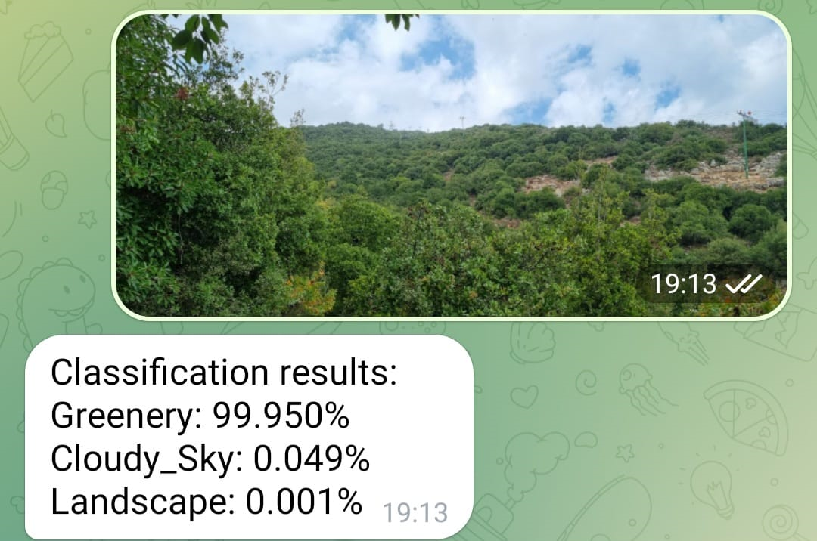
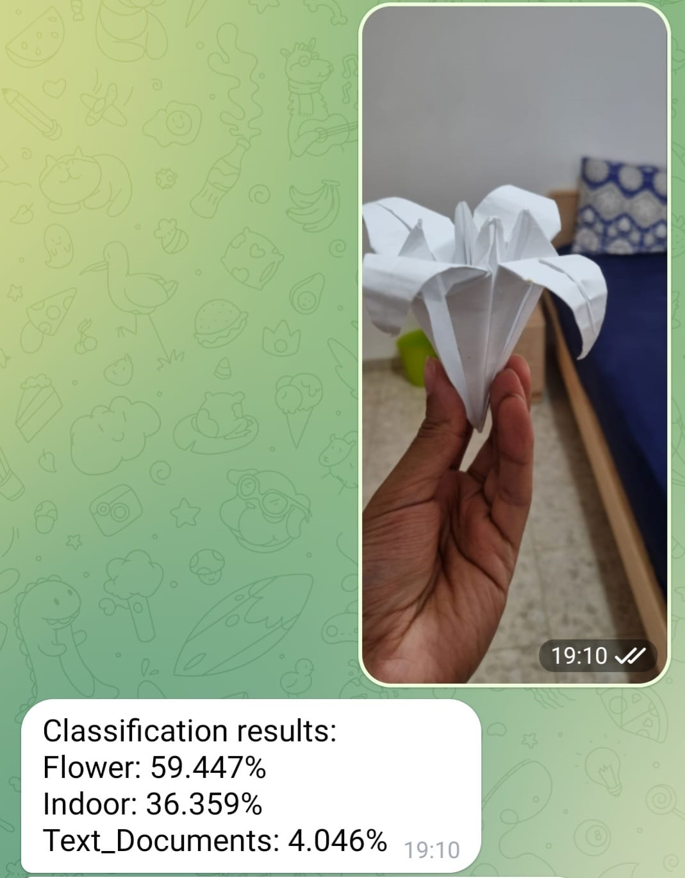
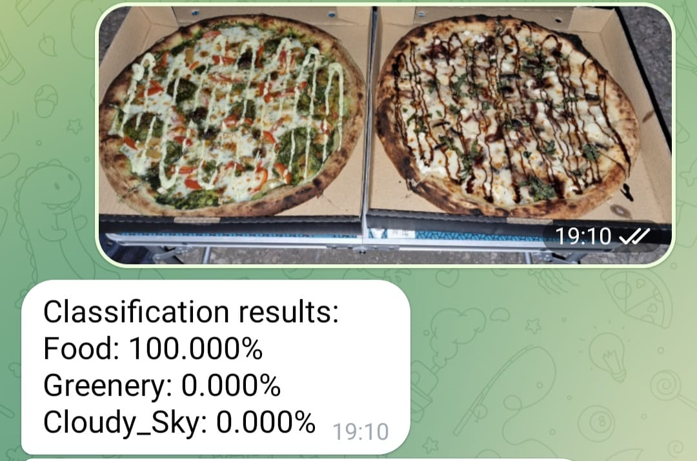
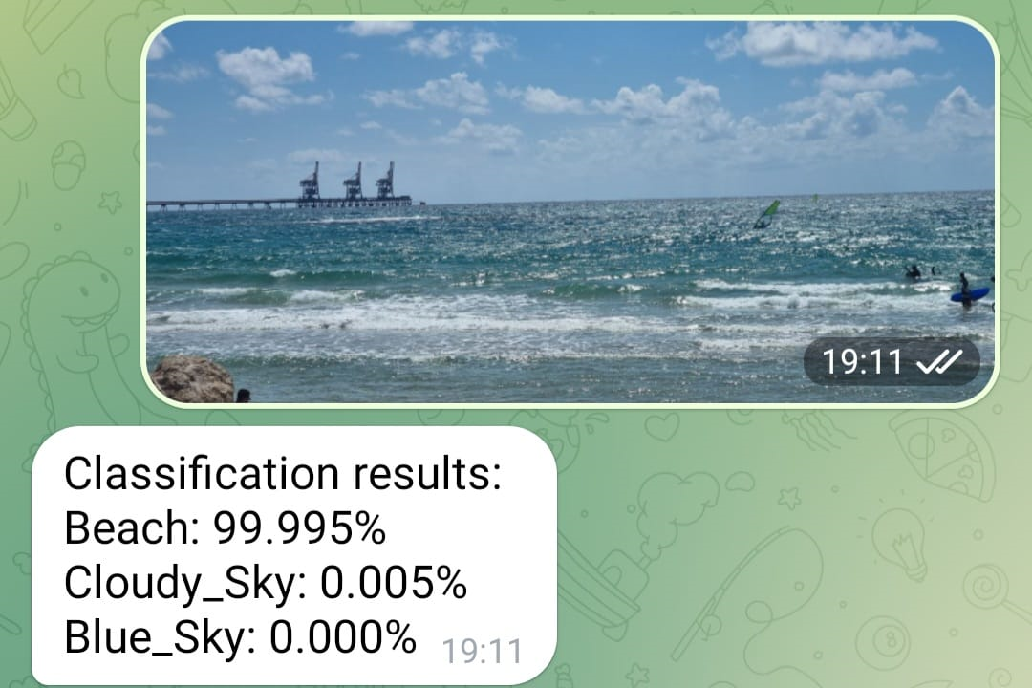



Thank You!
Experience the Interactive Bot
https://t.me/SceneDetection_bot

Slide 11
References
Our work based on: Fast and Accurate Camera Scene Detection on Smartphones by Angeline Pouget et al, 2021. URL https://people.ee.ethz.ch/~ihnatova/camsdd.html
Our work is inspired by: CLIPCAP (ClipCap: CLIP Prefix for Image Captioning, by Ron Mokady et al, 2021)
Clip Model: Learning Transferable Visual Models From Natural Language Supervision by Alec Radford et al, 2021
BLIP Model: Learning Transferable Visual Models From Natural Language Supervision by Alec Radford et al, 2021
BLIP-2 Model: Learning Transferable Visual Models From Natural Language Supervision by Alec Radford et al, 2021
LAVIS: A One-stop Library for Language-Vision Intelligence by Li, Junnan et al. 2023
LoRA: Low-Rank Adaptation of Large Language Models by Edward J. Hu et al. 2021
Fine-Tuning can Distort Pretrained Features and Underperform Out-of-Distribution by Ananya Kumar et al. 2022. URL https://github.com/salesforce/LAVIS
Places: A 10 million Image Database for Scene Recognition by Bolei Zhou et al.
Places365 Dataset Kaggle. URL https://www.kaggle.com/datasets/benjaminkz/places365

